Slide 1
Data visualization
Speech to text & Optical character recognition
Professor: Alexander Pak​
Master: Zhumabay Yerdaulet​

Slide 2
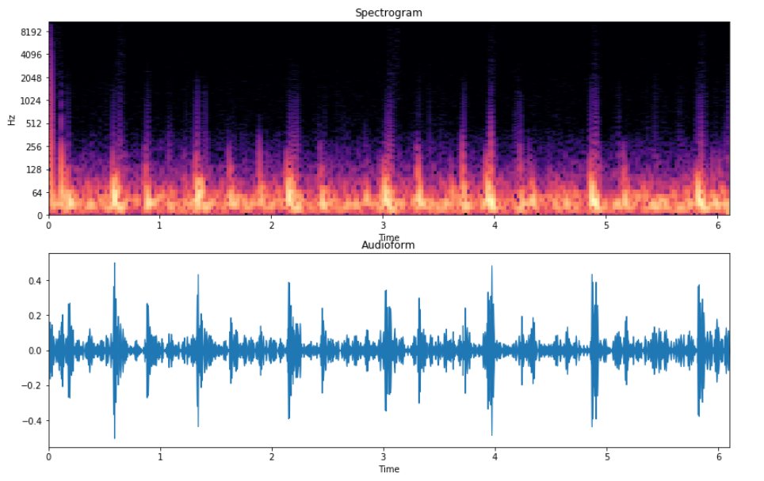
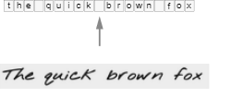
Speech-to-text & Optical character recognition
Spectrogram as an input image

Slide 3
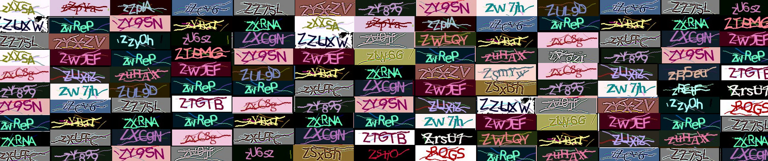
Optical character recognition Captcha Dataset
Captcha Dataset contains more than
113,000 colorful 5-character images.

Slide 4
Russian Open Speech To Text (STT/ASR) Dataset
The dataset contains 118,000 audio recordings. Audio recordings were
obtained using the Yandex.Toloka crowdsourcing platform. 66 people
participated in the creation of the dataset. People were offered sentences
for voice acting, it was necessary to pronounce sentences and record this
process on the phone.
A little frank information from the authors of the dataset:
Initially, the dataset was created for the Chinese customer Gstar-Marketing, but they disappeared without paying the full cost of the work for the project. In this regard, it was decided to lay out all the already collected records in the public domain (do not waste the good). Unfortunately, we have not implemented a project to validate and verify audio recordings, so the dataset is a bit "noisy" and may contain "defective" audio recordings.

Slide 5
Neural Network Arhitectures to Train:
Custom ResNet (Sequence-to-sequence)
Custom VGG (Sequence-to-sequence)
CNN with RNN, GRU, LSTM
Loss: Connectionist Temporal Classification

Slide 6
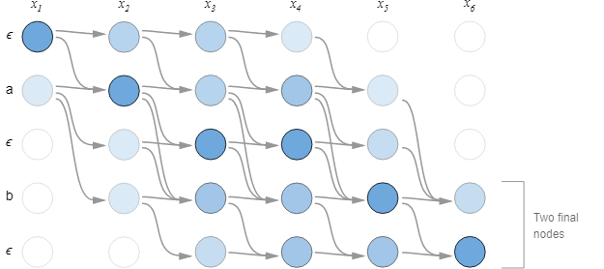
CTC Loss function

Slide 7
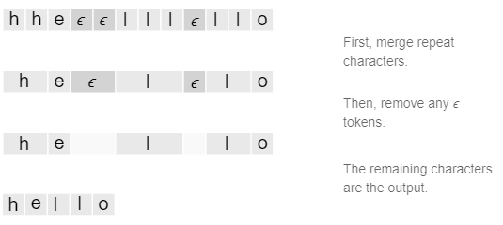
Decoding Model Prediction

Slide 8
Metrics
Error Probability of a Correctly Predicted Text
Correct number of predicted words
Correct number of predicted symbols
A custom metric:

